Slide 1
INCLUSIVE DESIGN THINKING

Slide 2
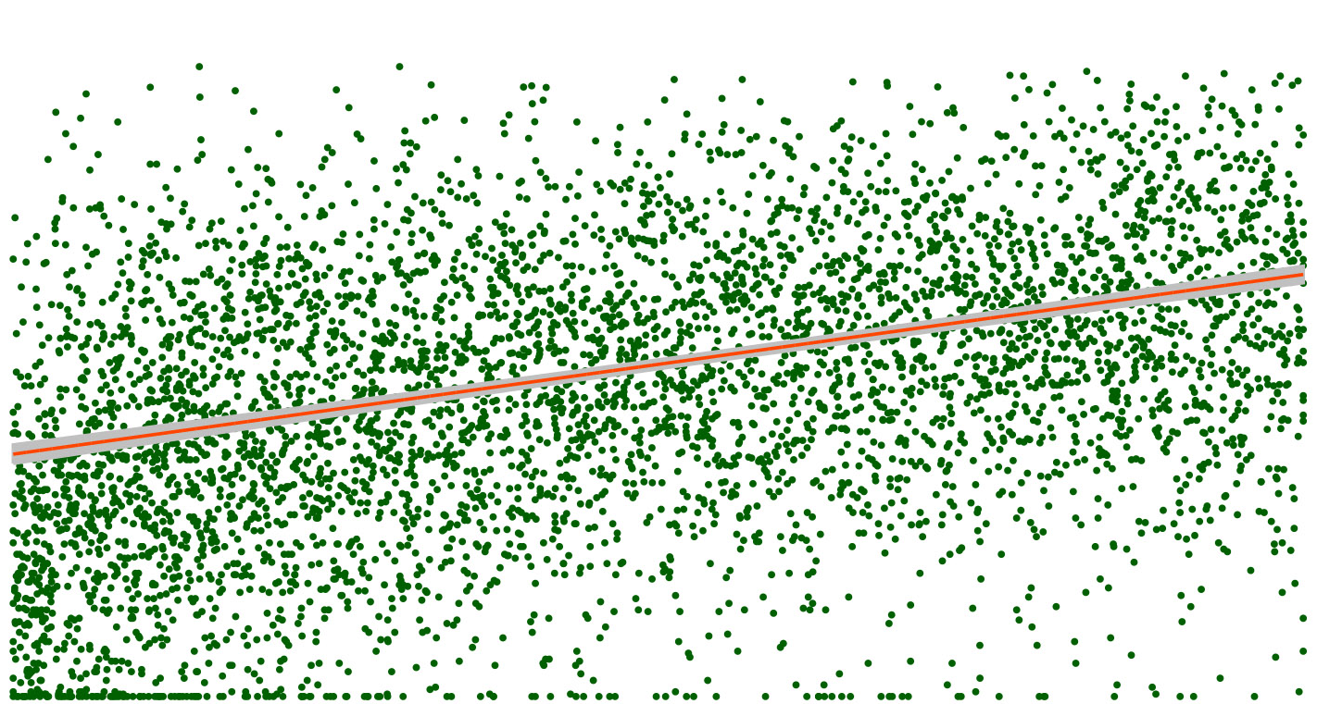
WHAT IS Inclusive Design?
Design that takes into consideration the full range of human diversity.

Slide 3
“We have clients come to us and say “Here’s our average customer.. She is female, she’s 34 years old, she has 2.3 kids…” and we listen politely and say “Well, that’s great but we don’t care about that person”. What we really need to do to design, is look at the extremes, the weakest, or the person with arthritis, or the athlete, or the strongest or the fastest person. Because if we understand what the extremes are, the middle will take care of itself”
Dan Formosa. Smart Design. “Objectified”

Slide 4
Notes:
The first working typewriter was built by Pellegrino Turri in 1808 for his lover Countess Carolina Fantoni da Fivizzano, who was losing her sight.

Slide 6
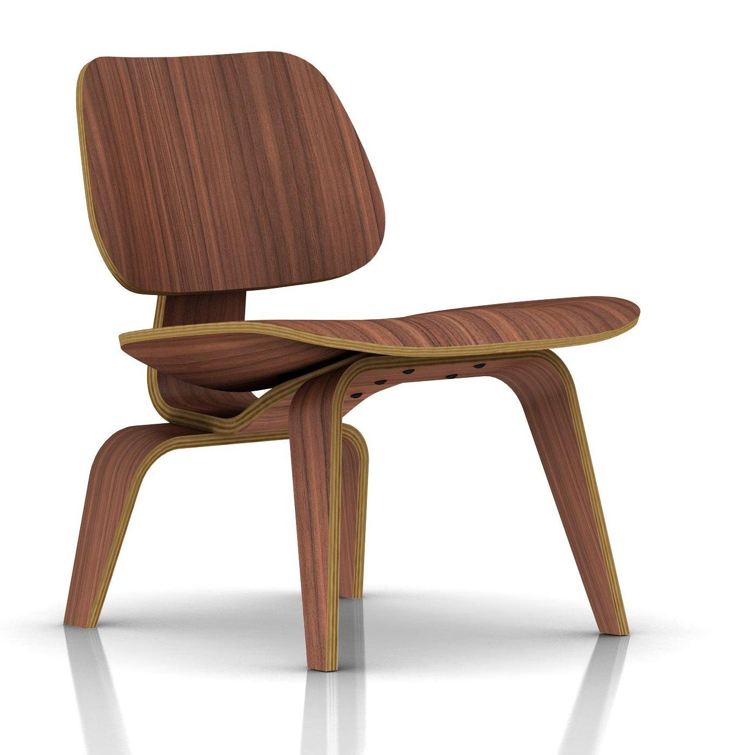

Slide 7
Notes:
https://www.youtube.com/watch?v=FNGp1aviGvE

Slide 8
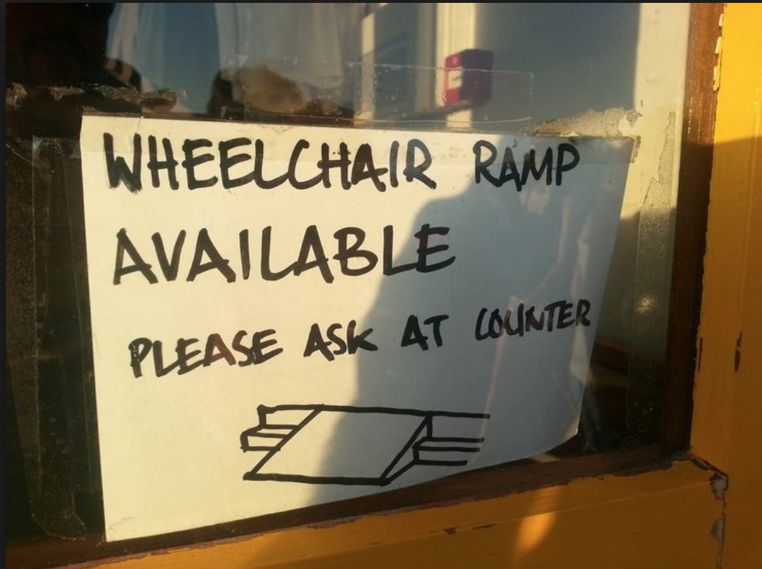
From physical to digital
Notes:
Physical barriers often open our eyes to the same kinds of problems

Slide 9
(Web) Accessibility Guidelines
Perceivable – Can I see it? Hear it? Feel it?
Operable – Can I move it? Control it? Navigate it?
Understandable – Can I understand it? Predict how it will behave?
Robust – Is it going to work in the future? Is it going to work reliably?

